Slide 1


HUM 102 Report Writing Skills
Lecture 29

Slide 2

Previous Lecture
Tenses
Subject Verb Agreement

Slide 3


Word Order Rules
Rules and Guidelines
Subject + Verb(s) + Object
I speak English
In case of using indirect objects, direct objects, place and time expressions
Subject + Verb + Indirect Object + Direct Object + Place + Time
I will tell you the story at school tomorrow

Slide 4
Word Order Rules
Rules and Guidelines
In case of subordinate clauses
Conjunction + Subject + Verb + Indirect Object + Direct Object + Place + Time
Because I don’t have time now.
If the emphasis is not on time, it can be placed at the beginning of a sentence
Tomorrow I will tell you the story.

Slide 5
Word Order Rules
Rules and Guidelines
In case of adverbs of frequency (always, never, usually), place these adverbs before the main verb (except for be as main verb)
Subject + Auxiliary/ be + Adverb + Main Verb + Object, place or time
I often go swimming in the evenings.
He doesn’t always play tennis.
We are usually here in summer.
I have never been abroad.

Slide 6
Word Order Rules
Rules and Guidelines
Adverb of manner (slowly, carefully, awfully) is placed after the direct object
Placed after the main verb in case there is no direct object
Subject + Verb(s) + Direct Object + Adverb
He drove the car carefully.
He drove carefully.
Same word order for adverb of place (here, there, behind, above) and adverb of time (tomorrow, yesterday)

Slide 7
Word Order Rules
Rules and Guidelines
Word Order in Questions
Interrogatives (W/H Expressions) are placed first.
Auxiliary verb (or the main verb ‘be’) comes before the subject.
Interrogative + Auxiliary Verb + Subject + Other Verb(s) + Indirect Object + Direct Object + Place + Time
What would you like to tell me?
Did you have a party in your flat yesterday?
When were you here?

Slide 8

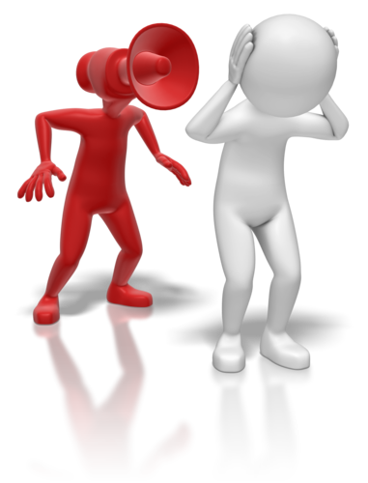
Barriers to Effective Communication
Introduction
At times, there are different faults in communication system which can become an impediment/barrier and affect the process of communication
Mechanical devices used for transmission may have some technical problem
Symbols used for communication
Nature of individuals engaged in communication

Slide 9
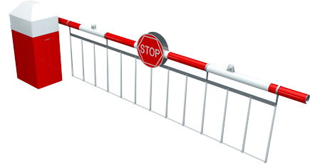

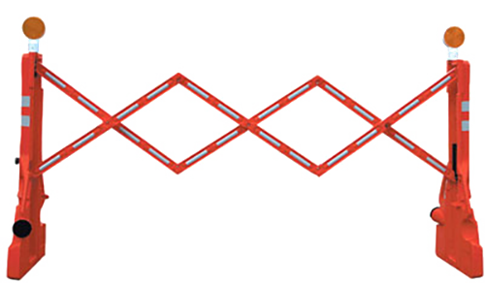
Barriers to Effective Communication
Division of Barriers
Physical Barriers
Semantic Barriers
Language Barriers
Socio-Psychological Barriers
Organizational Barriers
Cross-Cultural Barriers

Slide 10
Barriers to Effective Communication
Physical Barriers: Defects in the medium
Telephone, postal system, courier service, electronic media
All of this can cause delay, distortion and loss of a message
Sometimes, partial failure can be more harmful than a full failure of a mechanical equipment
Fax message delivered at a wrong number
Improperly printed document
Communication can be postponed for a while if there is no alternate solution for a while

Slide 11
Barriers to Effective Communication
Physical Barriers: Noise in the environment
Traffic, factory work, people talking
One solution for the organizations is to have sound-proof rooms
Information Overload
Too much information flowing through the media that a good deal of it does not reach the target audience
Advertising and sales information is flowing extensively through media and does not reach the potential buyer

Slide 12
Barriers to Effective Communication
Semantic and Language Barriers [1/4]
Barriers arising from different meanings of words
Charge, Head, Bank, Spring, Ring, etc.
Meaning would be derived based on area of interest
Charge would be an electrical charge for an engineering student
Charge would be fee or rent for a student commerce/business
Words like minute and wind can be pronounced in two different ways to have two different meanings
Position of stress on the word present can also convey two separate meanings

Slide 13
Barriers to Effective Communication
Semantic and Language Barriers [2/4]
There are words which are comprehensible in writing but misunderstood in speech
Access vs. Excess
Flower vs. Flour
Cite vs. Site
There are words whose orthography (spelling) is mixed even in writing
Week vs. Weak
Steel vs. Steal

Slide 14
Barriers to Effective Communication
Semantic and Language Barriers [3/4]
There are certain adjectives and adverbs which convey different meanings to different persons depending upon daily activities and way of life
Good, Bad, Beautiful, Ugly and so on
Word such as a table may suggest: writing table, dining table, statistical table
The word chair can be something to sit on or a place to occupy
What does the word home convey?
Emotional (past experience) and cultural attitudes towards something can evoke different responses in people, e.g., dog

Slide 15
Barriers to Effective Communication
Semantic and Language Barriers [4/4]
Phrases can be more tricky
A red and a blue carpet vs. A red and blue carpet
Sentences can convey entirely different meanings depending on how they are spoken what is being emphasized or stressed
What can I do for you?
Technical terms can also be a barrier to communication
Known to few
Most important: Meaning is in people, not in words

Slide 16
Barriers to Effective Communication
Socio-Psychological Barriers [1/8]
Problems of understanding, interpretation and response to communication arise partly from our socially-learnt attributes and partly from our personal attributes
A message is received at three levels:
Physical Level (noticing via senses)
Intelligence Level (comprehension)
Emotional Level (pleasure/dislike/indifference)
The emotional level is affected by these socio-psychological barriers

Slide 17
Barriers to Effective Communication
Socio-Psychological Barriers: Self-centered Attitudes [2/8]
Hearing everything in the light of our own interest, needs and desires
Paying attention only to messages which are useful to us
Not accepting others’ point of view
Not good for building good relationship with your audience

Slide 18
Barriers to Effective Communication
Socio-Psychological Barriers: Group Identity [3/8]
Opinions and values are influenced by the group to which we belong or associate ourselves
These groups include:
Family, relatives
Neighborhood, city, nationality
Class, college, university, organization
Nationality, age, gender, language
Ideas other than the ones accepted by a group are difficult to accept and are conventionally rejected (becomes a barrier)

Slide 19
Barriers to Effective Communication
Socio-Psychological Barriers: Self Image [4/8]
Self-image is our idea about what we are, what we look like and what impression we make
It is usually based on some truth and some exaggeration of our good points
Excess can lead to narcissism
A systematic self-assessment gives you a balanced self-image along with feedback from others

Slide 20
Barriers to Effective Communication
Socio-Psychological Barriers: Defensiveness [5/8]
If we feel threatened by a message, we become defensive and respond in such ways that reduce understanding
We may question the motives of others or become sarcastic or judgmental
Harmful barrier in handling complaints and grievances and in resolving conflicts

Slide 21
Barriers to Effective Communication
Socio-Psychological Barriers: Filtering [6/8]
Filtering is the process of reducing the details or aspects of a message
Information which has to be sent up the levels of hierarchy (vertical communication) has to be condensed and integrated for the senior managers
The more the levels of hierarchy in an organization, the greater is the filtering and loss of information
Similarly, organizational politics (withholding info among managers-horizontal communication) and the resultant filter can become a barrier as well

Slide 22
Barriers to Effective Communication
Socio-Psychological Barriers: Status Block [7/8]
Barrier developing from social/official distance between employer and employees
Resistance to Change
Serious psychological barrier
Resistance to new and better ideas which are against established opinions, traditions and social customs
A result of fear and a sense of insecurity

Slide 23
Barriers to Effective Communication
Socio-Psychological Barriers: Close/Narrow Mind [8/8]
Limited intellectual background, limited reading and narrow interests
Difficult to think out of the box
Poor Communication Skills
Poor productive (writing and speaking) skills can be the result of nervousness and excitement
Poor receptive (listening and reading) skills can be a psychological shortcoming and requires training to overcome
State of Health in the form of pain or fever also affects communication and becomes a barrier

Slide 24
Barriers to Effective Communication
Organizational/Professional Barriers [1/2]
In case of a long vertical or horizontal communication involving editing and filtering, there are more delays and distortions
Other causes of distortion can be misinterpretation, lack of understanding, neglect of message by some members
Another major cause is deliberate suppression of information out of self interest and jealously
A senior may change a good information/suggestion by a subordinate to take credit
A junior may suppress a bad news or information from reaching the managers to avoid affecting his/her repute
Withholding good information from peers perceived as rivals or claiming to be your own good suggestion can also become a barrier

Slide 25
Barriers to Effective Communication
Organizational/Professional Barriers: Over-dependence on Written Communication [2/2]
Circulars, bulletins, notices and even letters are not always read carefully
Oral communication has to be used to supplement written communication when the message is important

Slide 26
Barriers to Effective Communication
Inter-Cultural Barriers
Culture is a shared set of values and attributes of a group
It is the sum total of the ways of living built up by a group and transmitted from one generation to another
Culture is so much a part of an individual's manner of talking, behaving and thinking, that communication style and competence are influenced by it
Skill in communicating with people of other cultures is vital to success

Slide 27
Barriers to Effective Communication
Cultural Differences/National Character: Language [1/6]
Direct reflection of culture
Separate proverbs and idiomatic expressions which can not be translated into other languages
There are words which are not recognized by separate nations
For example: Free market by Russians
Different connotations of words in different cultures
In case of Japanese, yes means Yes, I’m Listening.
The Americans mean, Yes, I agree.
This difference can cause a little problem in negotiations

Slide 28
Barriers to Effective Communication
Cultural Differences/National Character: Values [2/6]
Our ideas of what is good and what is evil
Form the basis of our behavior and actions
Notions of good, evil and taboo vary across cultures
Social Relationships
Words to show family relations: cousin, uncle and aunt can create confusion across cultures
Caste system found in one nation may/ not be recognized by another nation

Slide 29
Barriers to Effective Communication
Cultural Differences/National Character: Time [3/6]
Eastern concept of time (circular) vs. western concept of time (linear)
Difference of focus between past, present and future among different cultures
For some: Time is money
For others: Relations are more important than time
Different perceptions of time lead to different work and social behavior
The idea of keeping work time strictly separate from personal time is a Western concept and is not easy for Eastern cultures to understand and follow
Professional punctuality also varies between eastern and western cultures

Slide 30
Barriers to Effective Communication
Cultural Differences/National Character: Space [4/6]
Concept of space also varies across cultures
Generally social and professional distance is less in east and more in west
Thought Process
Varies between cultures
Logical, clear, rational and law-based vs. holistic, emotional, superstitious and miracle-based

Slide 31
Barriers to Effective Communication
Cultural Differences/National Character: Non-verbal Behavior [5/6]
Indians use much more natural gesture than the British
The Japanese have many formal gestures for social interaction but less free body movements
Appearance
Ways of dressing and what is considered formal clothes is another problem area

Slide 32
Barriers to Effective Communication
Cultural Differences/National Character: Paralanguage [6/6]
Intonation (rise and fall), stress, pauses, interruption are interpreted differently across cultures
The Japanese believe, “Those who know do not speak-those who speak do not know”
Americans fill the silence by speaking
Interruptions are generally accepted in east but tolerated in west (convention is turn taking)
Perceptions
Eskimos concept of snow

Slide 33
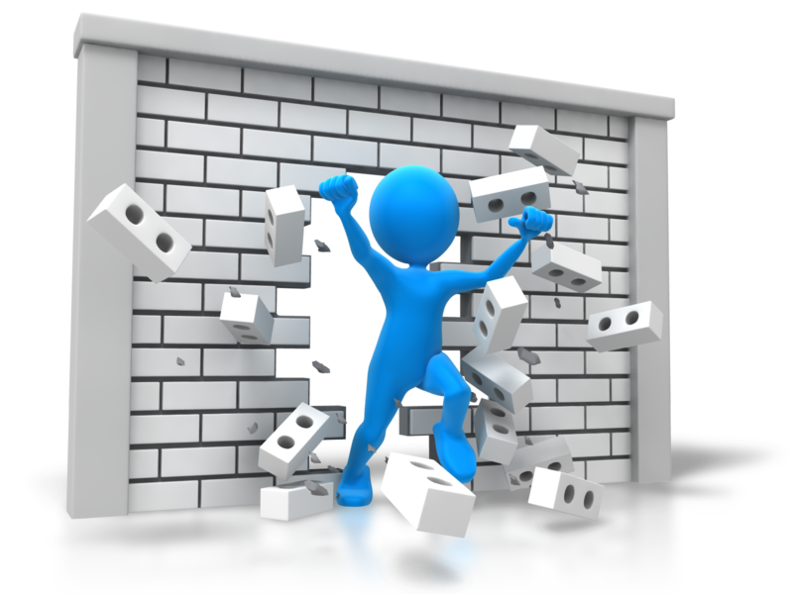
Barriers to Effective Communication
Overcoming Barriers
Constant organizational efforts
Health programs
Use of visual aid
Feedback

Slide 34
Conclusions
Word Order Rules
Basics of Barriers to Effective Communication
Division of Barriers
Overcoming Barriers

